Slide 1
Cluster Analysis Sindhu Bommali

Slide 2
agenda
Hierarchical Clustering with Jaccard Distance
VisualizATION clustering as dendrogram
visualiZATION OF clusters IN binary risk tags
HEATMAP OF CLUSTER CENTROIDS

Slide 3
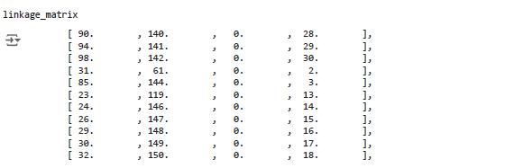
Hierarchical Clustering with Jaccard Distance
Using the complete linkage method, we perform hierarchical clustering.
Complete linkage considers the maximum distance between observations in two clusters.

Slide 4
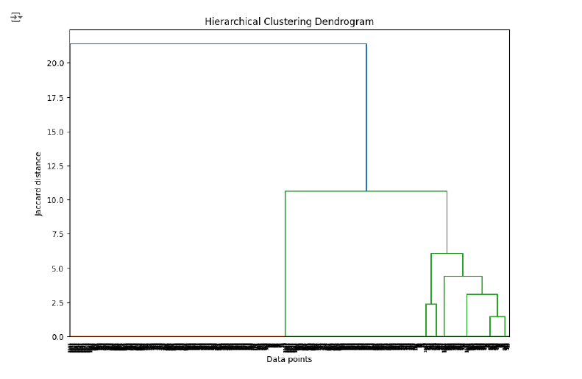
Visualization clustering as dendrogram
The dendrogram shows how each cluster is linked, with the y-axis representing the distance (dissimilarity) at which clusters are merged.
The height of the merge point indicates the similarity between clusters: lower heights suggest greater similarity.

Slide 5
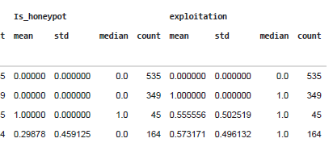
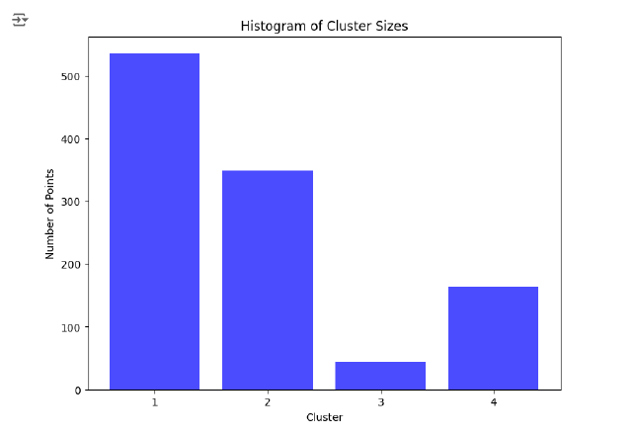
Visualization Of clusters in Binary Risk Tags

Slide 6
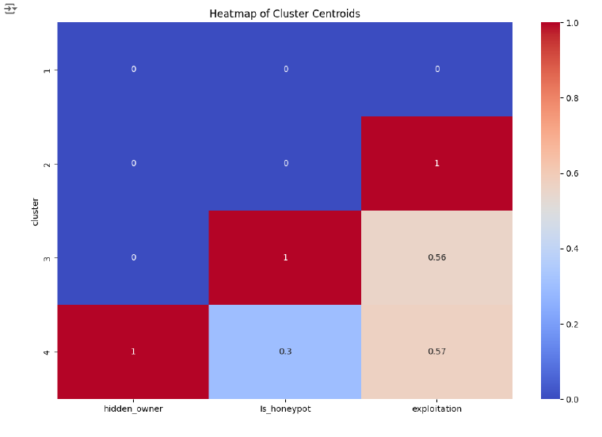
HEATMAP OF CLUSTER CENTROIDS

